Slide 1

EMF-based (de-)serialization of FHIR documents
Joerg Kiegeland
Keith Duddy

Slide 2






S23M external collaboration
support services
customer facing services
operate
domain analysis
enterprise architecture
design
standards
innovation

Slide 3



S23M internal collaboration
enterprise architecture
domain engineering
big picture
agile methods
programming
detail oriented
informal
formal

Slide 4
This talk
FHIR is a model-based formalism
Let’s try:
Generating instead of programming
Applying open source tools

Slide 5
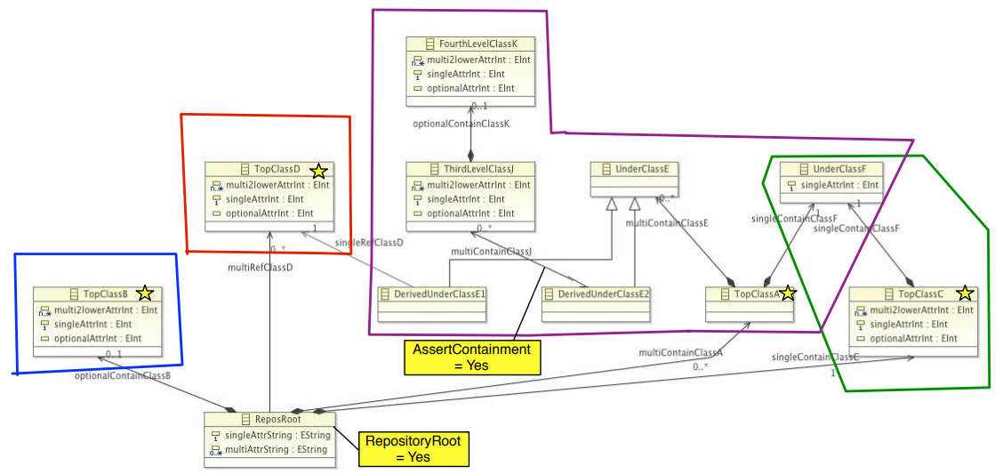
Idea: Serialize “containment” trees
There are no non-containment references in the FHIR model

Slide 6
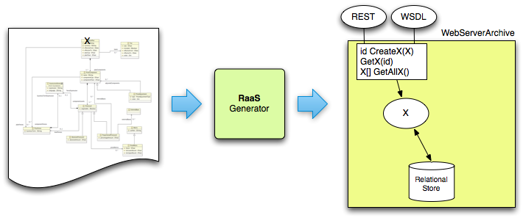
Generate 3 Tier Applications From annotated models
. . . etc

Slide 7
3 Tier Applications
Generated by Repository as a Service
. . .

Slide 8
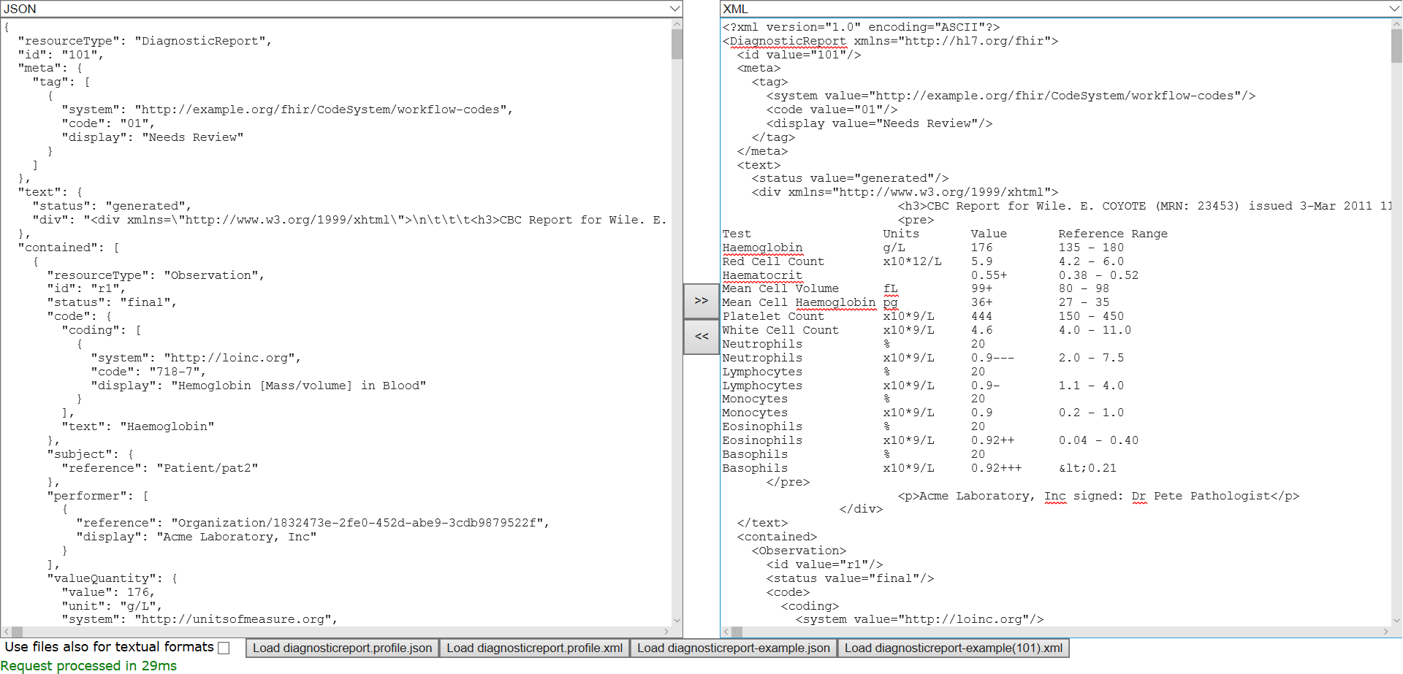
Spring-Boot does Relational Layer

Slide 9
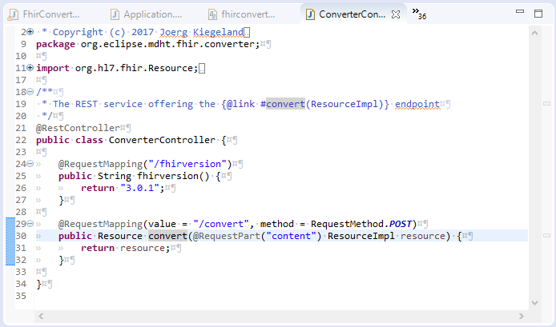
Spring generates a REST controller

Slide 10
RaaS (Repository as a Service) approach
Annotate generated Java code with JAXB annotations
JAXB annotations are part of Java JDK, so no additional dependencies
Install wizard from update site
https://raw.githubusercontent.com/patins1/raas4emf/master/plugins/org.eclipse.jqvt.updatesite

Slide 11
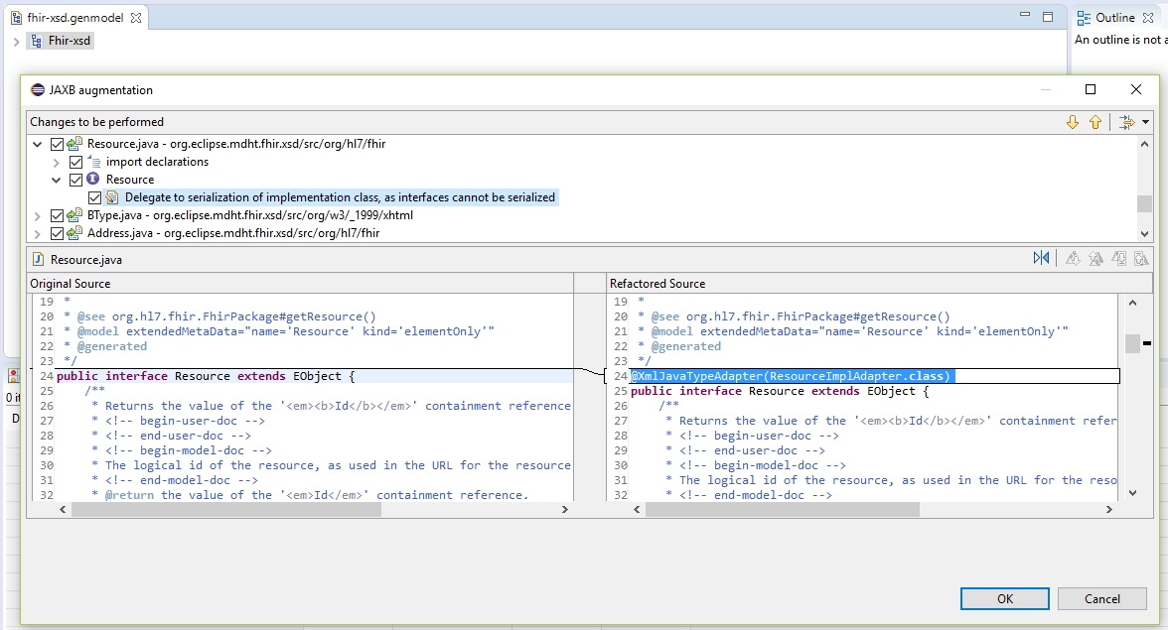
RaaS Generator wizard

Slide 12
Further customization
Use Jackson Mixins to provide further customizations
We identified two Mixins for FHIR

Slide 13
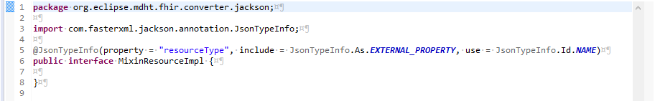
Mixin 1
Add resourceType attribute that is not part of the XML schema

Slide 14
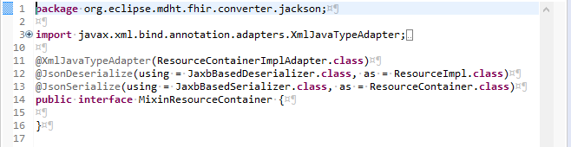
Mixin 2
Flatten ResourceContainer in JSON format but not in XML format by using custom Jackson serializer

Slide 15
Advantages of RaaS approach
New FHIR versions can be integrated in less than 10 minutes just by code generation
A wide range of Jackson formats are successfully tested
Performance is similar to HAPI library

Slide 16
How we tested correctness
We downloaded examples-json.zip
Every JSON file was converted
original.json => raas.json => hapi_1.json
original.json => hapi_2.json
Assuming that the HAPI library is functional correct, comparing files hapi_1.json and hapi_2.json showed what our (de)serialization raas.json changed in the document

Slide 17
Known functional issues
“date” type has formatting problems
Problems with some property namings, like “class” and “_code”
patient-example-b.json has a parsing error in the included base64 encoded photo, but all other example json files could be read and converted
Comments are not preserved

Slide 18
Performance results
For all JSON files in examples-json.zip (114MB)
RaaS took 32 seconds
HAPI took 30 seconds
For all XML files in examples.zip (73MB)
RaaS took 16 seconds
HAPI took 18 seconds

Slide 19
Supported formats
JSON
XML
YAML – “YAML Ain't Markup Language”
Java Properties
BSON – MongoDB
CBOR - Concise Binary Object Representation
Smile -binary serialization of generic JSON data model
Amazon Ion
Protobuf, CSV, AVRO, msgpack need further investigation (they have not a fixed schema)

Slide 20
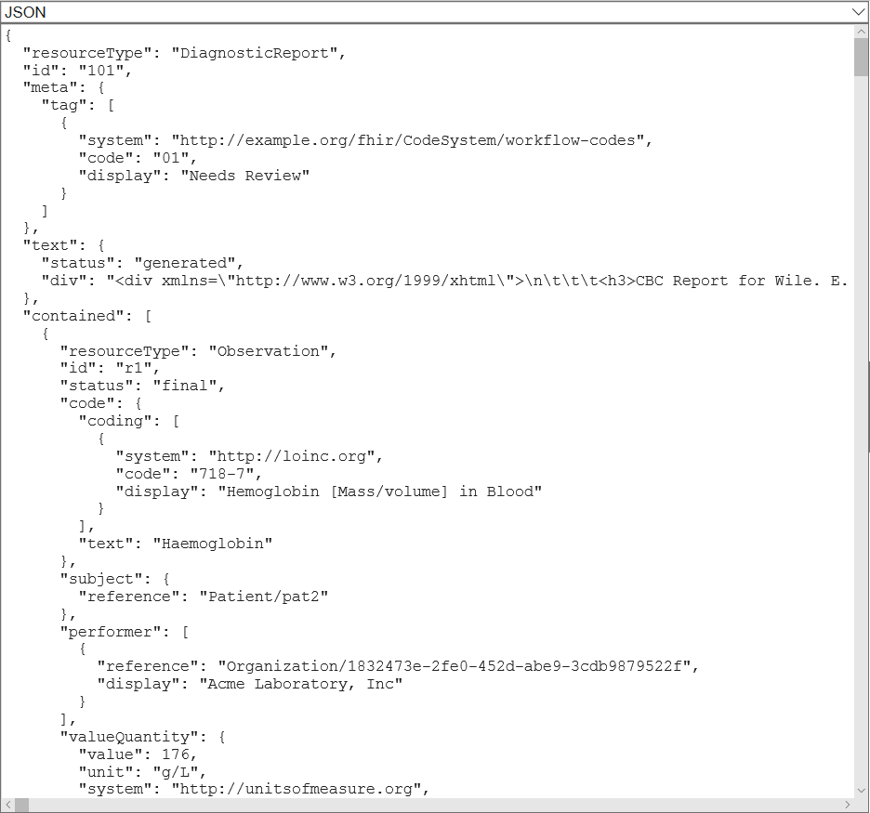
Screenshot: JSON DiagnosticReport

Slide 21
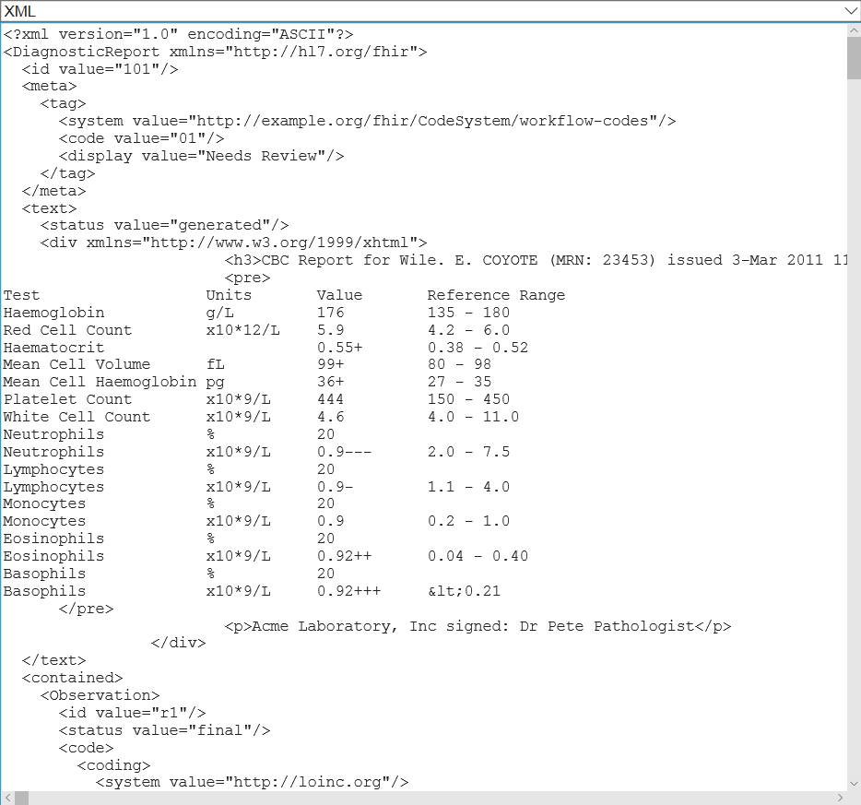
Screenshot: XML

Slide 22
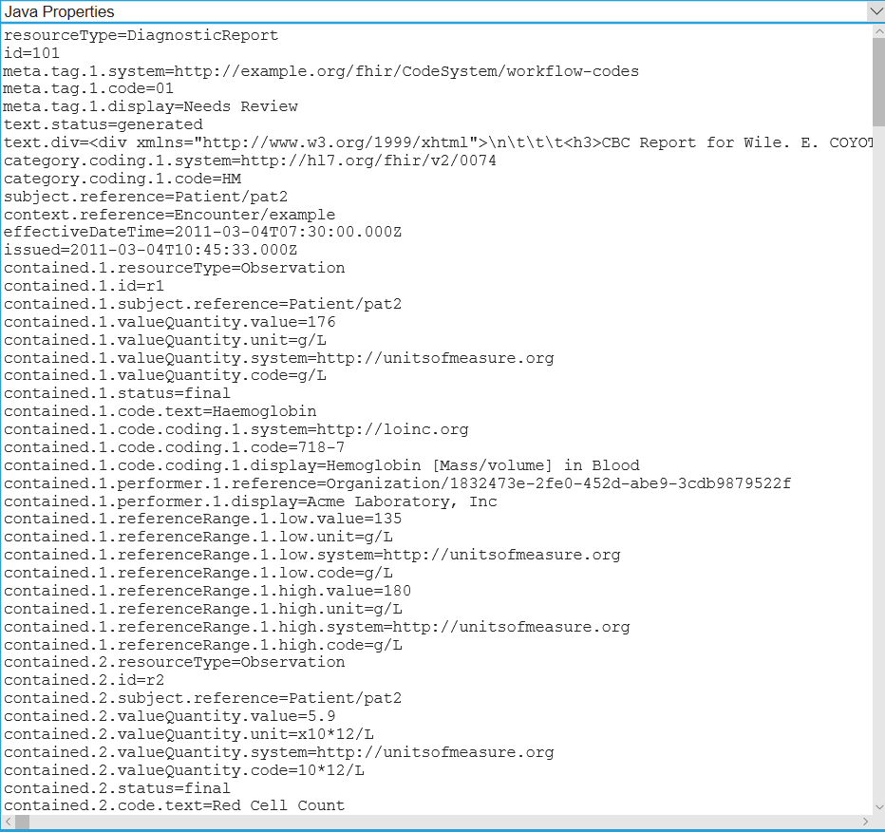
Screenshot: Java Properties

Slide 23
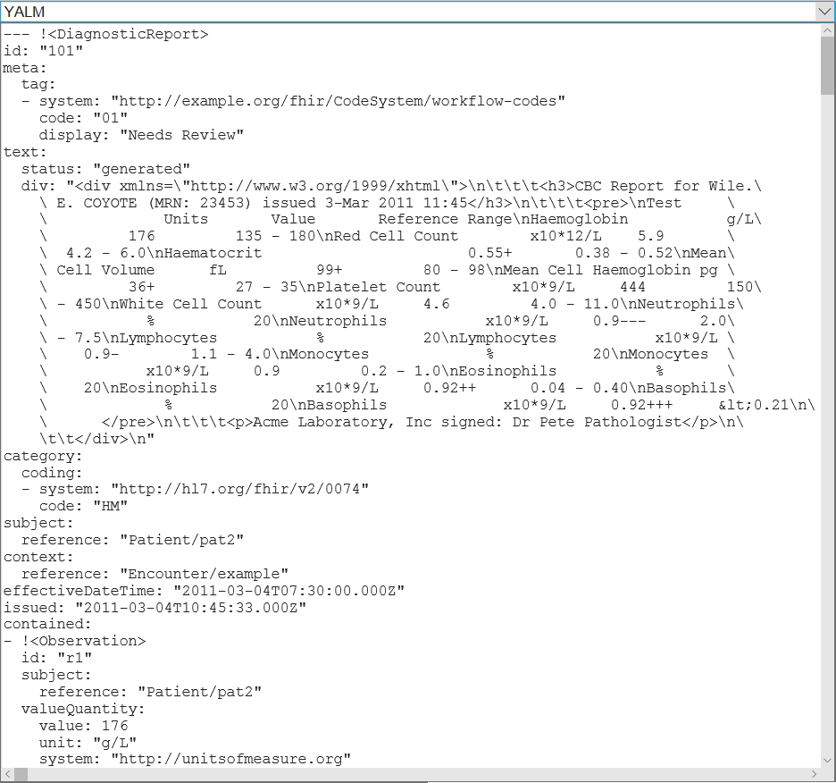
Screenshot: YAML

Slide 24
Open Source
This prototype is EPL licensed and (soon) official part of MDHT
The prototype has 1140 Java lines of code and 383 HTML5 lines of code
90% of this code can be applied to any EMF metamodel, so refactoring would be useful!

Slide 25

Thank you!
S23M
info @ s23m.com
Nothing beats capturing the knowledge flow of leading domain experts to co-create organisations & systems that are understandable by future generations of humans & software tools.

